Slide 1
Using Machine Learning Methods to
Identify and Classify the Regions and Projections of Online Maps
Jialin Li and Ningchuan Xiao
Department of Geography
Sep 20, 2019

Slide 2
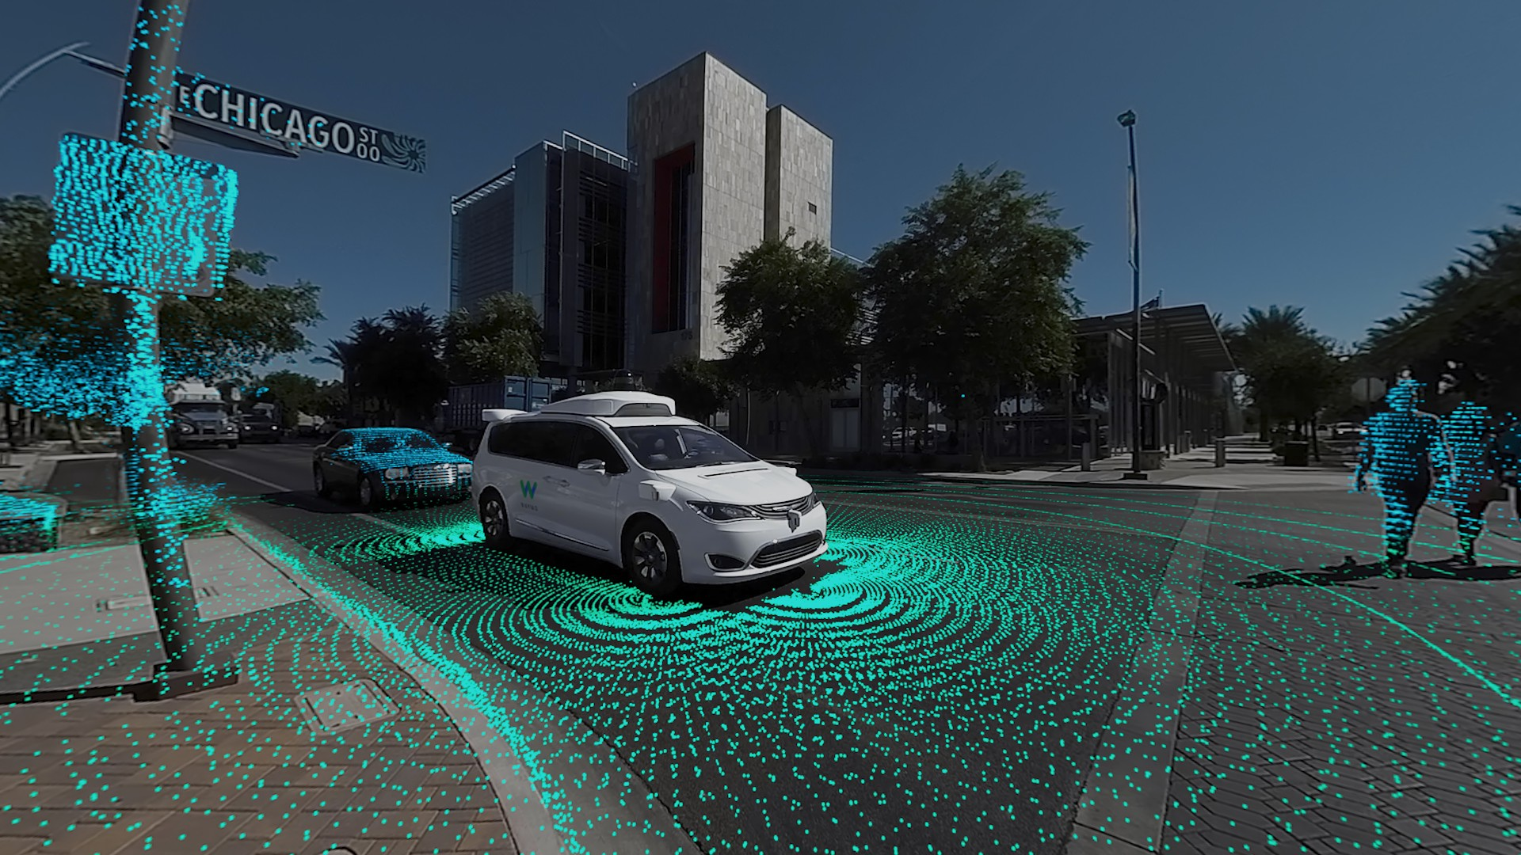

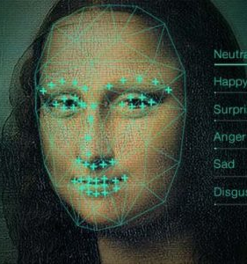
Introduction
The evolution of machine learning, especially the development of convolutional neural networks, prompts new trends of machine learning applications in computer vision
Self-driving car
Image classification
Face recognition
Notes:
In the past years…

Slide 3
Research Questions
Can a machine understand images such as maps?
Research questions:
Is the provided image a map?
Which geographical region is this map about?
Which projection is used in this map?
We identified and tested three methods that have potential in this research:
SVM (support vector machine)
MLP (multilayer perceptrons)
CNN (convolutional neural network)

Slide 4
Literature Review
Lots of relevant research in other fields including remote sensing image, medical image and plant image
Bentes, Velotto and Lehner (2015) use a self-designed CNN (Convolutional Neural Network) to conduct object classification in oceanographic SAR images.
Qian et al. in 2015 compare four machine learning classifiers for land cover classification using very high-resolution images
Mohanty et al. in 2016 utilize 54306 images to train AlexNet and GoogLeNet architectures in Deep CNN to identify 26 diseases from 14 distinct crop species.
Few research about map identification and classification
Zhou et al. (2018) applied several state-of-the-art Deep CNN to test their performance on map-type classification. The map types include topographic map, 3D map and nighttime imagery map.
Notes:
There are

Slide 5
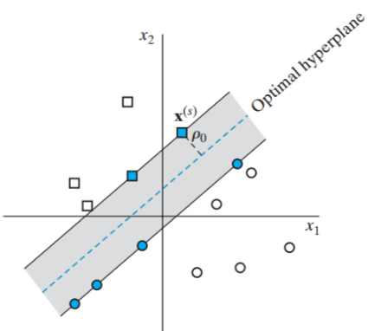

Support Vector Machine (SVM)
(Source: Haykin, 2009. Neural Networks and Learning Machines.)
(Source: https://www.hackerearth.com/blog/developers/simple-tutorial-svm-parameter-tuning-python-r/)
Notes:
The first method used in our project is …
SVM wants to find an optimal hyperplane that can be used to separate the points into classes. A hyperplane is optimal if it exhibits a maximum margin between the classes and minimal misclassification error
When the points are linearly inseparable, kernel functions are used to transform the original data into a higher dimensional space so that the optimal hyperplane (linear) can be found

Slide 6
Support Vector Machine (SVM)
Find an optimal hyperplane to separate inputs into classes
Optimal hyperplane: a hyperplane with a maximum margin between the classes and minimal misclassification error
For linearly inseparable cases, transform the original data into a higher dimensional space using kernel functions
Four commonly-used kernel functions were tested
linear, polynomial, radial basis function and sigmoid kernels
Five-fold cross validation was used to find the optimal combination of parameters

Slide 7
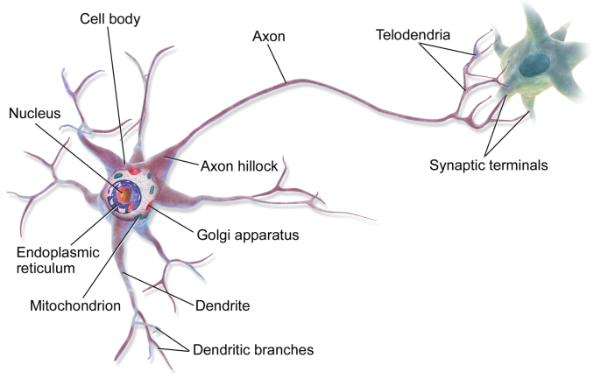
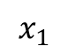
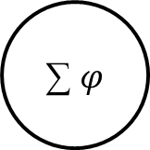
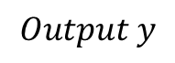
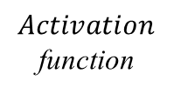
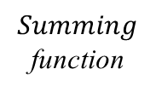

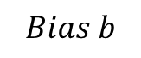

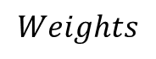
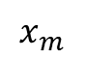

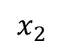
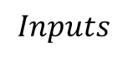
Multi-layer Perceptrons (MLPs)
Perceptrons are the basic elements of MLPs
$$Bias b$$
$$x_{1}$$
$$w_{1}$$
$$x_{2}$$
$$w_{2}$$
∑ $φ$
$$Output y$$
……
……
$$Summing$$
function
$$Activation$$
function
$$x_{m}$$
$$w_{m}$$
$$Inputs$$
$$Weights$$
Notes:
Each of the input value multiplies a corresponding weight to make a sum and plus the bias value b, and then use an activation function to calculate the final output y
And MLP is a network with many perceptrons

Slide 8
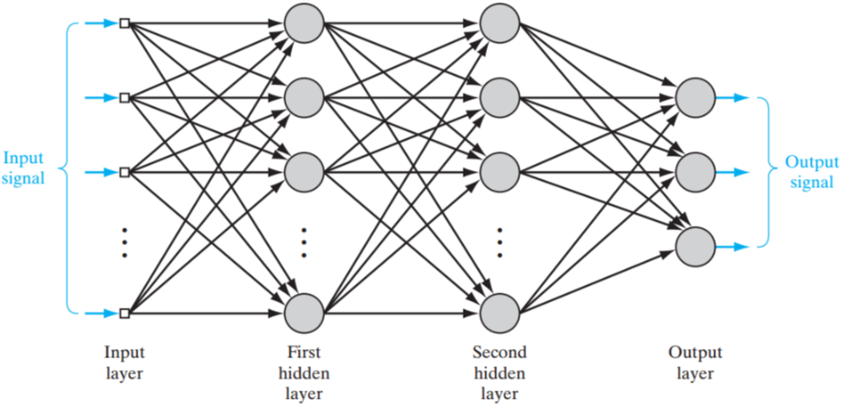
Multi-layer Perceptrons (MLPs)
MLPs are a type of feed-forward neural networks
Traditional shallow networks
(Source: Haykin, 2009. Neural Networks and Learning Machines.)
Notes:
They use training data to adjust the weights between adjacent layers of nodes based on their observed output value and desired value.
MLPs are classical traditional shallow networks with many problems, and the problems are solved by convolutional neural net

Slide 9

Convolutional Neural Network (CNN)
CNN can discover structures in images
Convolutional layers are designed to discover features of different levels
The structure of CNN can largely reduce the number of parameters and make deeper networks feasible
(Source: https://towardsdatascience.com/a-comprehensive-guide-to-convolutional-neural-networks)

Slide 10
Convolutional Neural Network (CNN)
In this study, many self-designed networks were tested
Transfer learning using pre-trained CNN architectures was also used in the experiments
Two commonly-used pre-trained architectures: VGG16 and VGG19 by Visual Geometry Group from Oxford
The VGG network architecture was introduced by Simonyan and Zisserman in 2014
VGG networks are one of the most commonly-used pre-trained architectures
The “16” and “19” stand for the number of weight layers
Notes:
Till now we ‘ve already used VGG16 and VGG19 to do the three tasks

Slide 11
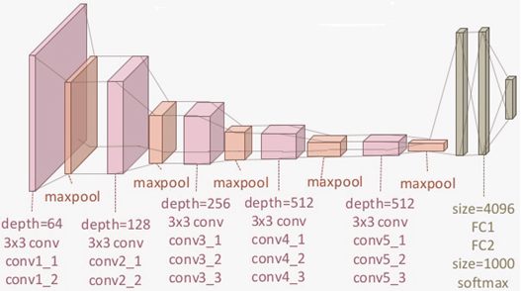
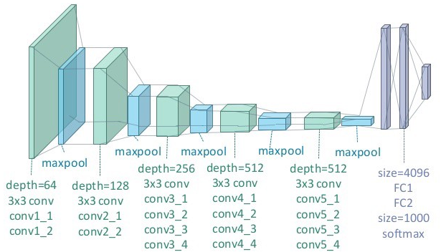
Convolutional Neural Network (CNN)
VGG16
Architecture
VGG19
Architecture
(Source: https://towardsdatascience.com/transfer-learning-in-tensorflow)
Notes:
The two architectures are shown here

Slide 12
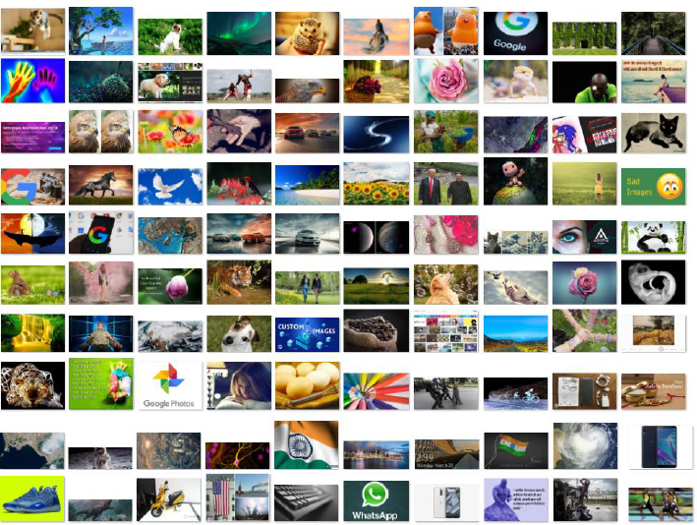
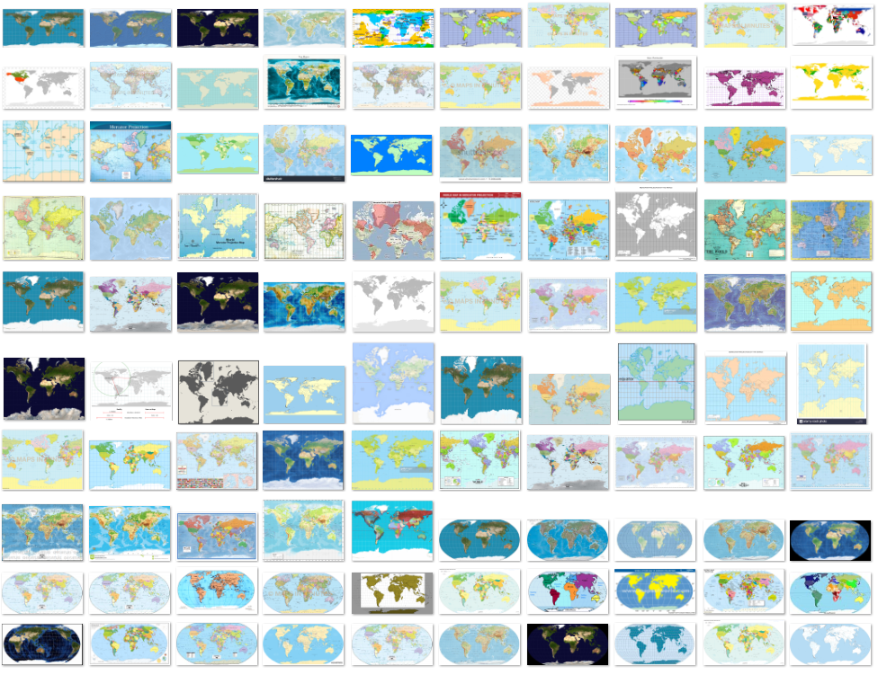
Data: Map Identification
500 non-map images and 500 world map images

Slide 13
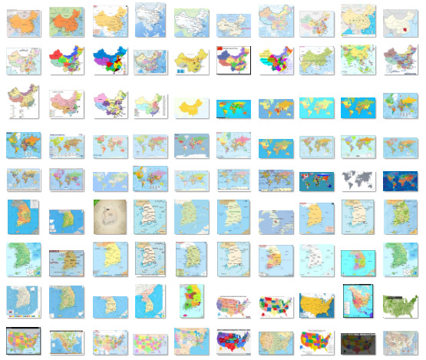
Data: Region Classification
250 maps for each of four regions (China, the U.S., South Korea and the World)

Slide 14
Data: Projection Classification
100 map images for each of four world map projections (Equirectangular, Mercator, Miller and Robinson projection)
Notes:
As for projection classification, because it is really hard to find world maps with the same projection online…
Check the properties of projections.

Slide 15


Tools
TensorFlow
Open-source machine learning library by Google
Keras
Runs on top of TensorFlow
Designed to enable fast implementation
Used for MLPs and CNNs
LIBSVM
A popular open-source SVM library to implement SVMs
Notes:
We used Keras library for MLPs and CNNs
LibSVM for SVMs
Keras runs on top of TensorFlow, which is the most popular open-source machine learning library by Google.

Slide 16
Computational Experiments
For map identification and region classification, 70% images are training data, and the rest 30% are testing data
For projection classification, 90% images are training data and 10% are testing data
The inputs for all three methods are pixel values in three bands of each image (3*120*100 input nodes)
For SVMs, MLPs and CNNs trained from scratch, only CPU (Intel Core i7-8700, 3.2GHz) was used to run the program
For transfer learning using pre-trained CNN architecture, the program ran on Google Colab with GPU (Nvidia Tesla K80, 2496 CUDA cores, 12 GB memory)
Google Colab is a Jupyter notebook environment that requires no setup to use and runs entirely on the cloud
Notes:
because the number of images of different projections is relatively small
Try the number of hidden layers from 1 and increase it to see the trend of outcoming testing accuracy, similarly with number of nodes.
For the three methods, only CPU was used to run the program
For transfer learning, the program ran on Google Colab with GPU

Slide 17
Hyper-parameters
MLPs
CNNs
Parameters | Values or Choices
Activation function | Rectified linear unit (ReLU)
Optimizer | Stochastic gradient descent
Learning rate | 0.01
Number of epochs | 100
Parameters | Values or Choices
Activation function | Rectified linear unit (ReLU)
Kernel size | 5*5
Pool Size | 2*2
Strides | 2*2
Optimizer | Stochastic gradient descent
Learning rate | 0.01

Slide 18
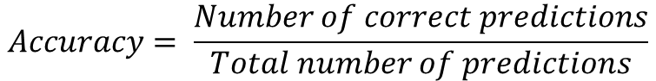
Results: Map Identification
$$Accuracy= \frac{Number of correct predictions}{Total number of predictions}$$
Methods | Training Accuracy | Testing Accuracy
MLP | 0.931 | 0.903
SVM | 0.998 | 0.857
CNN | 0.997 | 0.950
The best result is from CNN with three convolutional layers, and the kernel numbers of each layers are 16, 64, 256
All of the three methods can get high testing accuracy, and CNN is the best in general and also the most stable method
Notes:
OK, let’s see the results
Accuracy is calculated by dividing the number of correct predictions by the total number of predictions
As we can see from the table, the best result is from CNN, and the best CNN model has three convolutional layers…

Slide 19
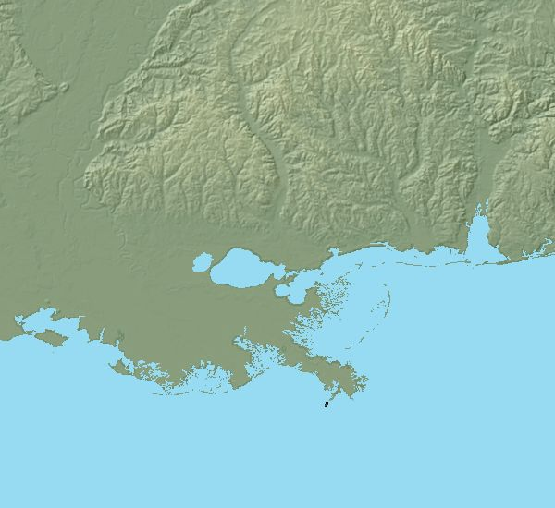
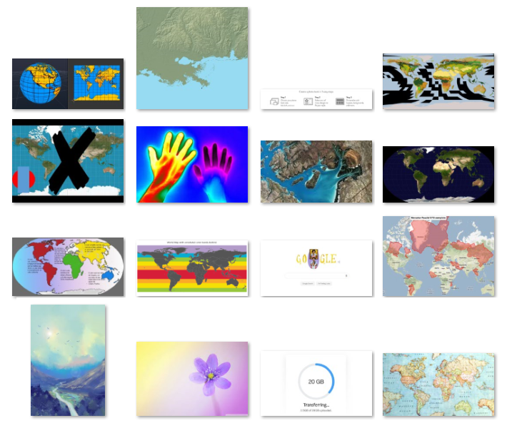
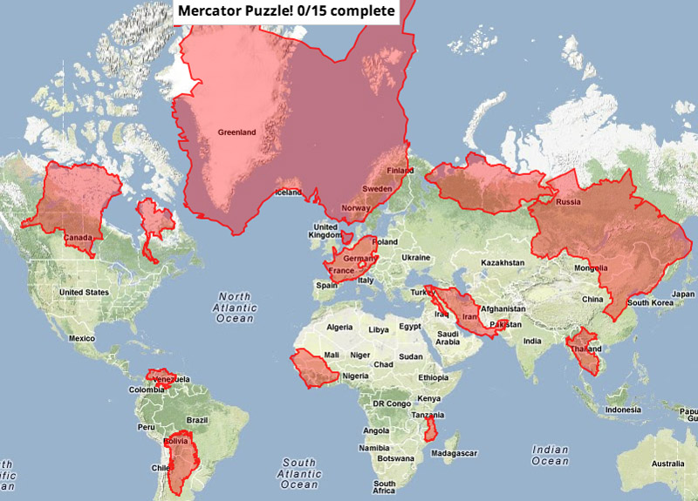
Results: Incorrect Predictions
Notes:
The incorrect predictions are shown here. The first image is identified as a world map image, but it should not be. I think the similar feature of this image with world map confused the machine. And the second one is indeed a world map image, but with some mask, the machine cannot successfully identify it.

Slide 20
Results: Region Classification
Methods | Training Accuracy | Testing Accuracy
MLP | 0.764 | 0.784
SVM | 0.998 | 0.790
CNN | 0.999 | 0.837
The testing accuracy rates of the three methods are not as good as those for map identification
The best result is from CNN with two convolutional layers, and the kernel numbers of each layers are 32 and 64
CNN’s training accuracy is much higher than testing accuracy
Notes:
It indicates that there are some overfits in the model, more training data is needed to improve the testing accuracy.

Slide 21
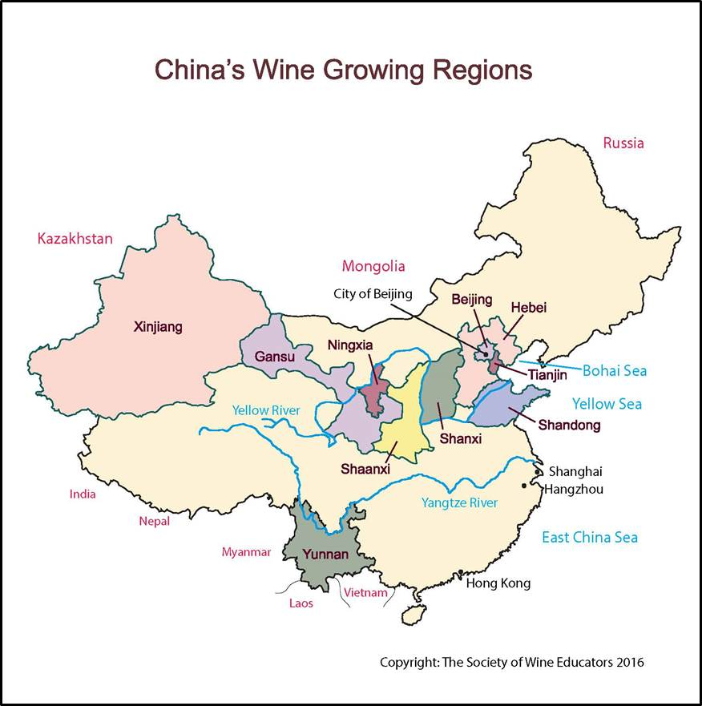
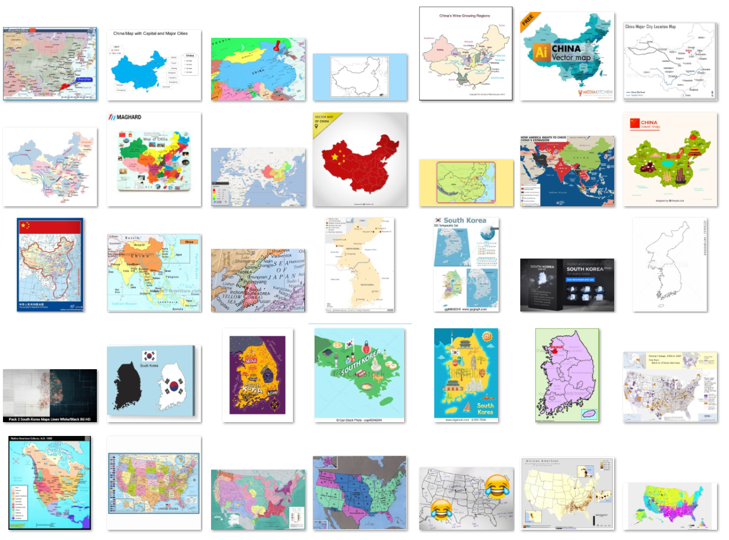
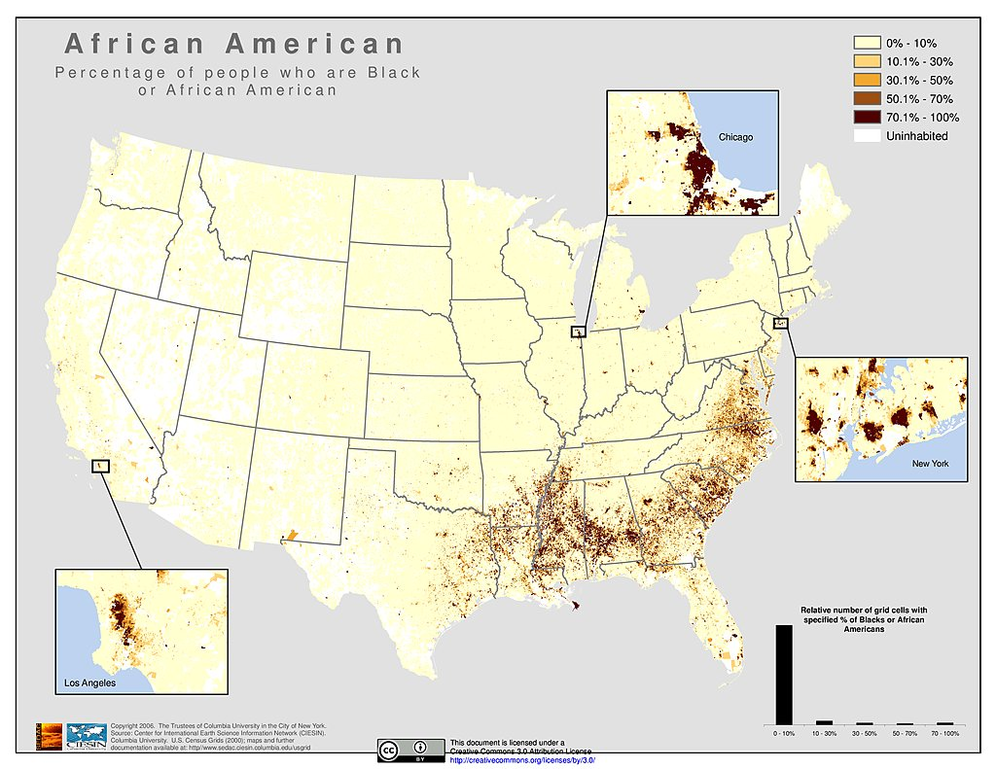
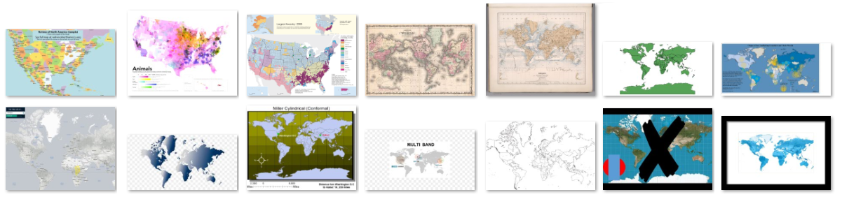
Results: Incorrect Predictions

Slide 22
Results: Projection Classification
Methods | Training Accuracy | Testing Accuracy
MLP | 0.764 | 0.775
SVM | 0.998 | 0.85
CNN | 0.999 | 0.9
The testing accuracy rates of the three methods are not as good as those for map identification
The best result is also from CNN with two convolutional layers, and the kernel numbers of each layers are 64 and 128

Slide 23
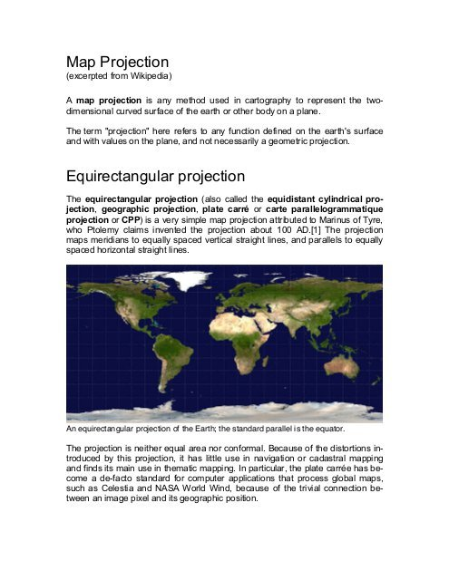
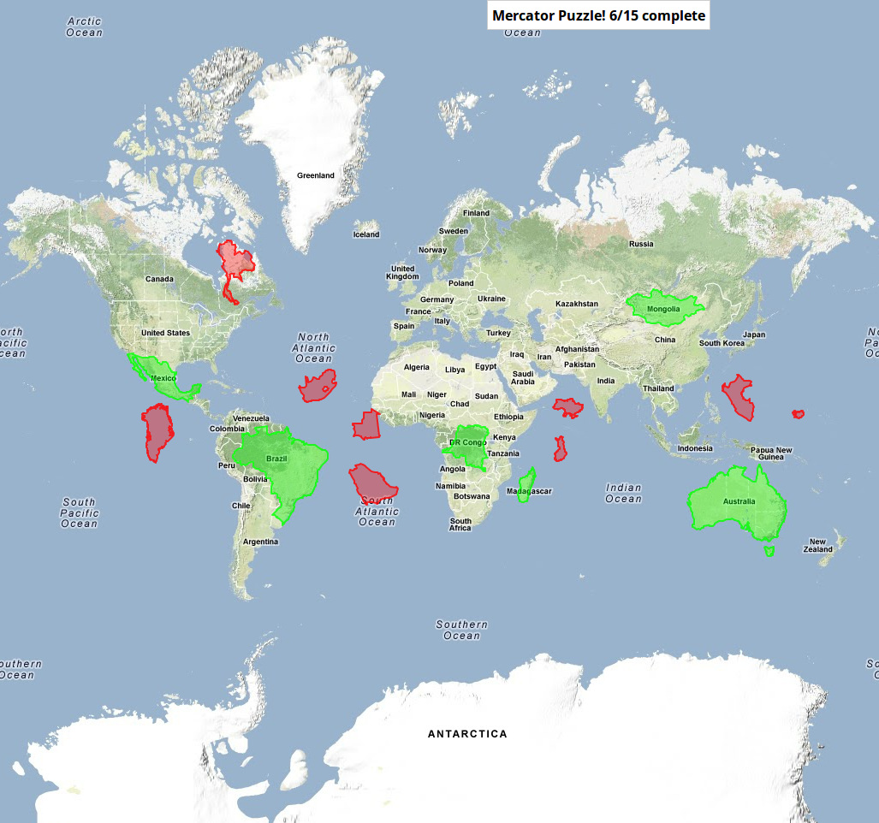

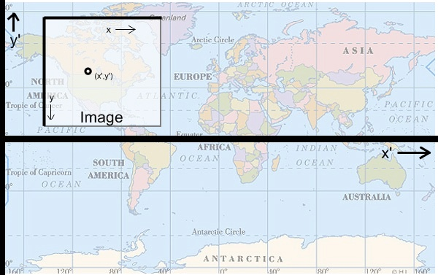
Results: Incorrect Predictions
Equirectangular - Robinson
Mercator - Miller
Miller - Mercator
Miller - Mercator
Notes:
The black projection names are the desired classification result and the red names are the predicted projections by our model.

Slide 24
Results: Training Size
Models with more training data will obtain higher accuracy rate
Choose map identification as an example
Notes:
For the testing accuracy with different training size, we can see there is a raising trend of accuracy as training size increases.

Slide 25
Results: Transfer Learning
Task | Methods | Training Accuracy | Testing Accuracy
Map identification | CNN from scratch | 0.997 | 0.950
 | VGG16 | 0.989 | 0.987
 | VGG19 | 0.999 | 0.987
Region classification | CNN from scratch | 0.999 | 0.837
 | VGG16 | 0.997 | 0.933
 | VGG19 | 0.997 | 0.947
Projection classification | CNN from scratch | 0.999 | 0.9
 | VGG16 | 0.972 | 0.675
 | VGG19 | 0.972 | 0.725
Notes:
And for transfer learning, we can see it performs significantly better than our best CNN models for map identification and region classification.
But for projection classification, it works not as well as CNN trained from scratch because of the small number of training images for projection classification.

Slide 26
Results: Training and Testing Time
Task | Methods | Training Time (s) | Testing Time (s)
Map identification | CNN from scratch | 1749.42 | 0.69
 | VGG16 | 901.54 | 4.36
 | VGG19 | 1101.46 | 5.87
Regional classification | CNN from scratch | 2618.63 | 0.60
 | VGG16 | 528.97 | 3.51
 | VGG19 | 1136.71 | 6.23
Projection classification | CNN from scratch | 362.56 | 0.11
 | VGG16 | 203.50 | 0.67
 | VGG19 | 255.67 | 0.85
Notes:
Identification -5
Region -3
Projection -4
Identification -6
Region -3
Projection -4
As for the time, VGG16 can always get the shortest training time, and CNN trained from scratch has the shorted testing time.

Slide 27
Summary
Significance of our research work:
Basic research field in AI and machine learning
Fundamental work of automatic map understanding
A good assistant for blind or vision-impaired users to extract information from map images
Useful for image retrieval and update in an image database
Future work:
Try more state-of-the-art pretrained CNN architectures
Use high-performance computation techniques to reduce computing time
Notes:
Our work can be a …

